Slide 1
Schooling in rural Sindh:
who can read, and what families pay
1,440
students with
education spending
ECO346 · Assignment 1 · Data Visualization Techniques for Economists
Zunaira Zahid · FA24-BED-098 · Section B
Variant 2: Sindh, rural · PSLM 2019–20, weighted by hhweight
7,171
persons aged 10–64
with literacy observed
Notes:
Introduce yourself and your variant: 98 = 12 x 8 + 2, so variant 2, Sindh rural. Two questions: what do households spend per student, and how does literacy change with age for women and men.

Slide 2
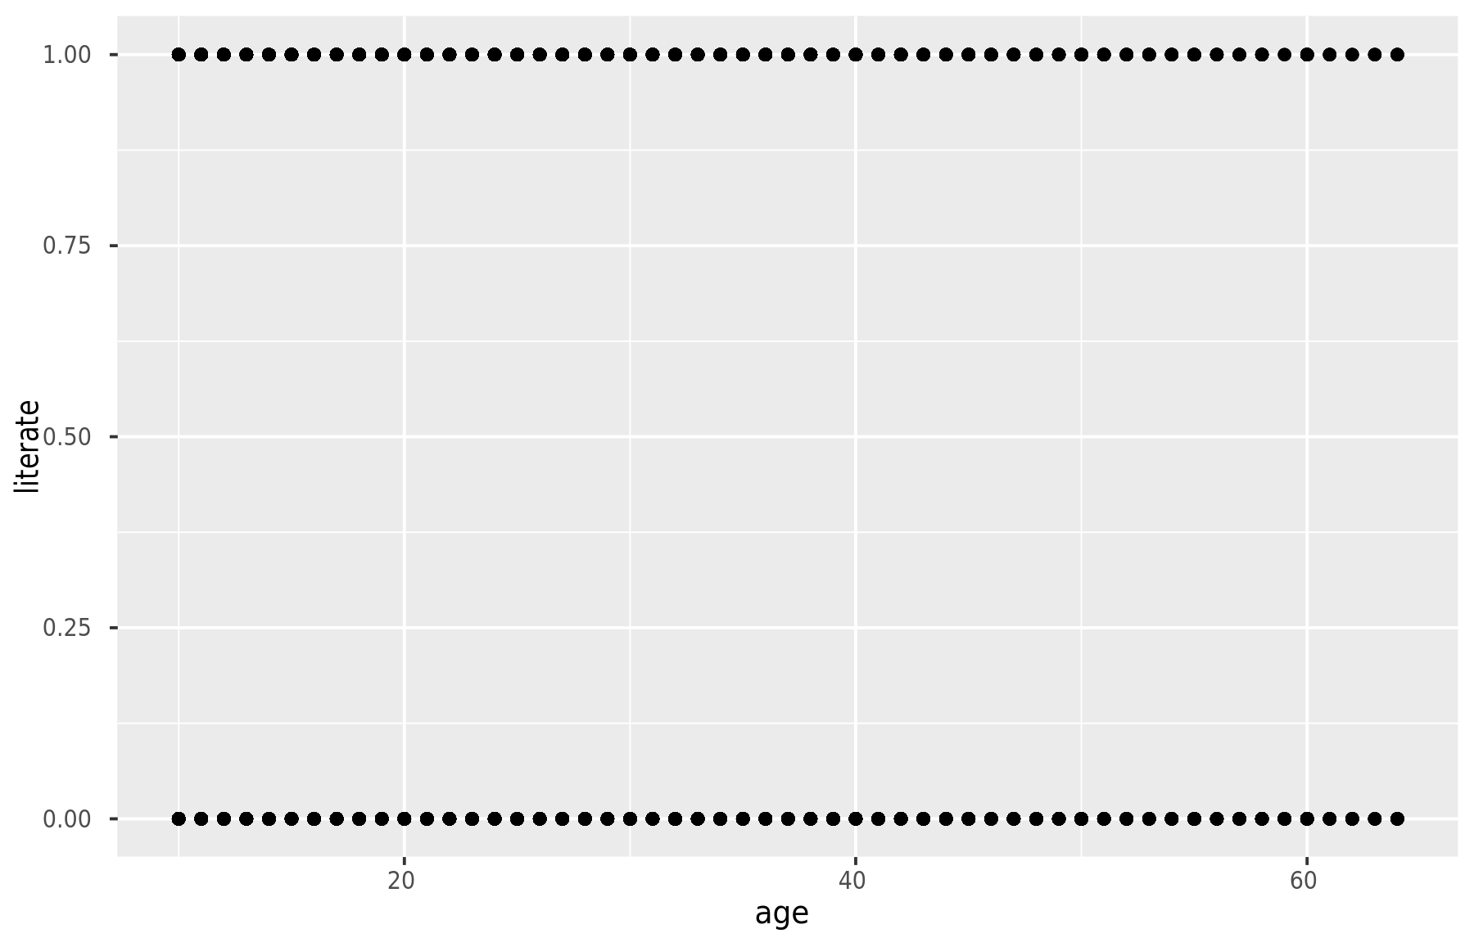
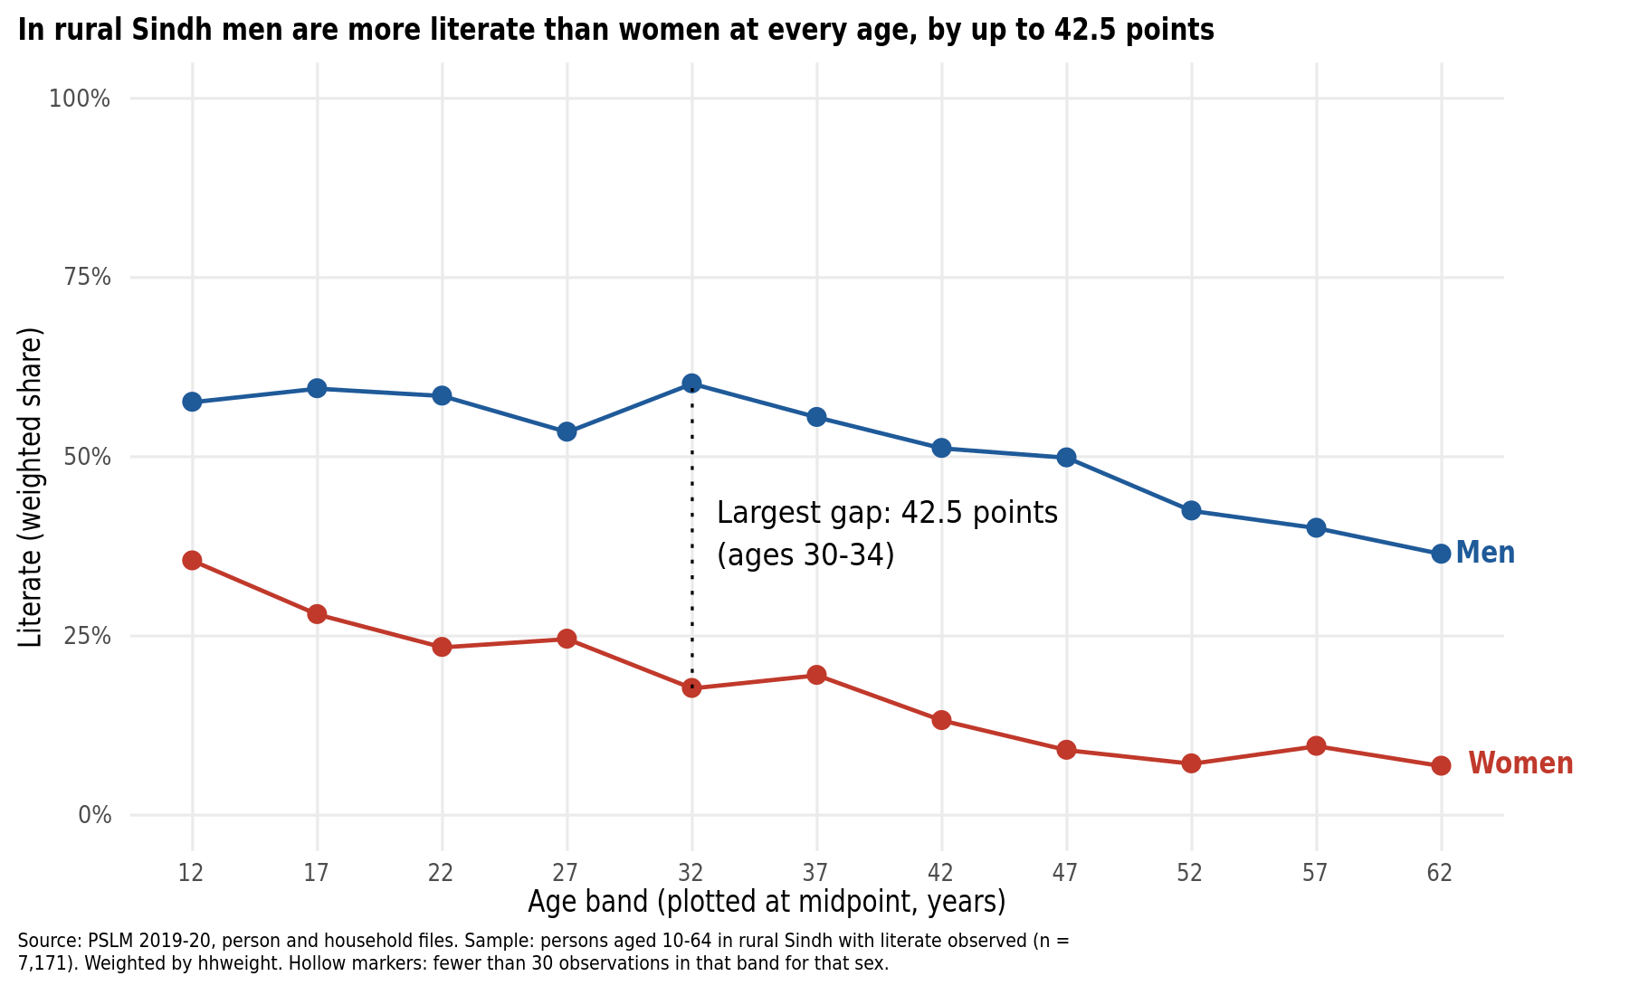
Makeover: from a cloud of dots to a finding
Default: R's defaults, untouched
Redesign: weighted rates by age band
Conditional means replace 7,171 overlapping 0/1 dots, so the trend is visible
Position on a common scale, direct end labels and no legend: less data-ink
Hides: individual observations and the sample size behind each point
Notes:
Left: the R default, geom_point only. Right: my redesign. Three changes: conditional means (overplotting), position on a common scale with direct labels (perceptual ranking, data-ink), and a title that states the finding. The default shows individual observations that the redesign hides.

Slide 3
At ages 30–34, 60% of rural Sindh men but only 18% of women can read
42.5 pts
largest gap between men and women (ages 30–34)
28.0%
of women aged 15–19 can read (men: 59.5%)
Source: PSLM 2019–20, rural Sindh, weighted by hhweight
Notes:
Most important finding: the gender gap in literacy is large at every age and widest at 30-34 (60.2% vs 17.7%, a gap of 42.5 points). Women's literacy falls from 35.5% at 10-14 to 6.8% at 60-64. Limitation: one cross-section, so we cannot separate age effects from cohort effects.

Slide 4
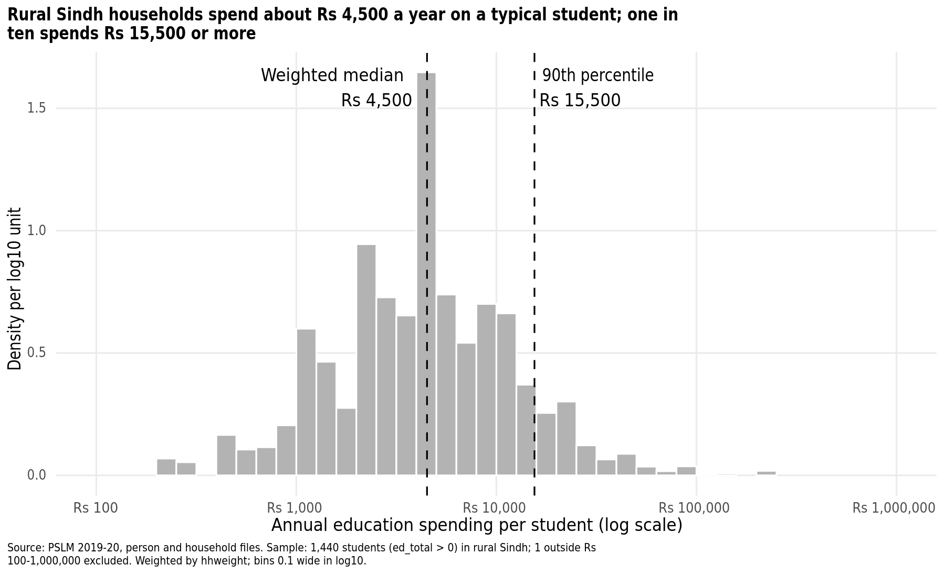
A typical student costs Rs 4,500 a year; one in ten costs Rs 15,500 or more
Rs 4,500
weighted median (unweighted: Rs 4,295)
15.5×
90th percentile (Rs 15,500) over 10th (Rs 1,000)
Right-skewed: weights lift the median only slightly.
Notes:
Weighted median Rs 4,500, unweighted Rs 4,295; p10 Rs 1,000 and p90 Rs 15,500, ratio 15.50. One student (Rs 6) is outside the Rs 100 to Rs 1,000,000 range and is excluded from the histogram.

